Slide 1
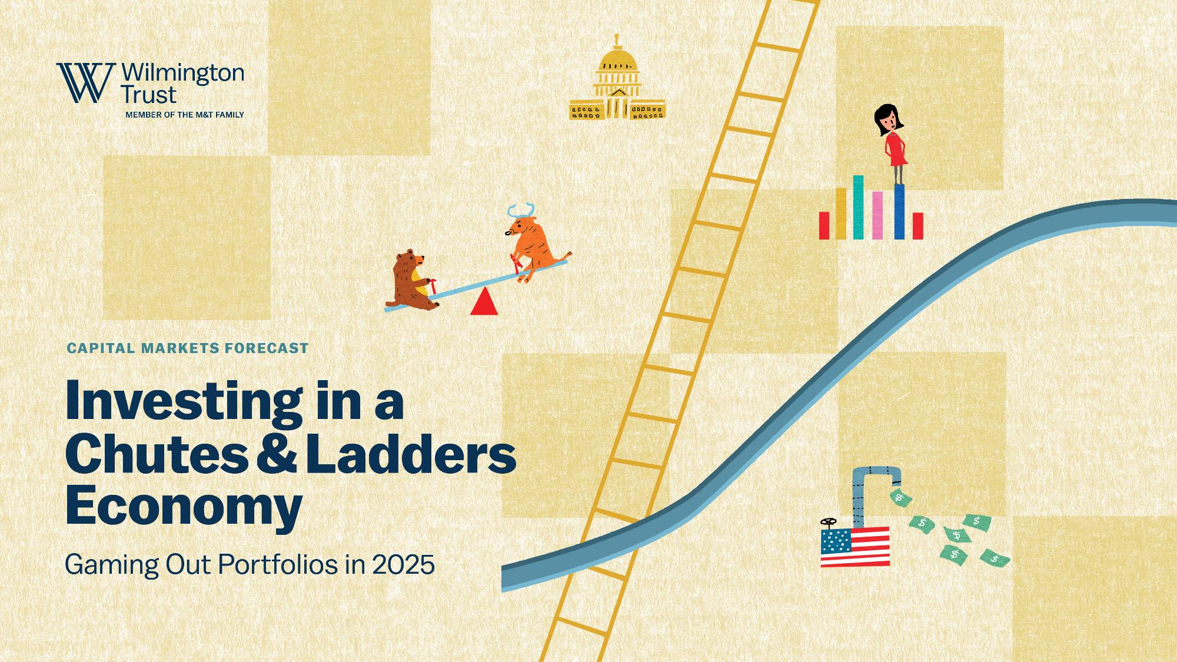

Slide 2

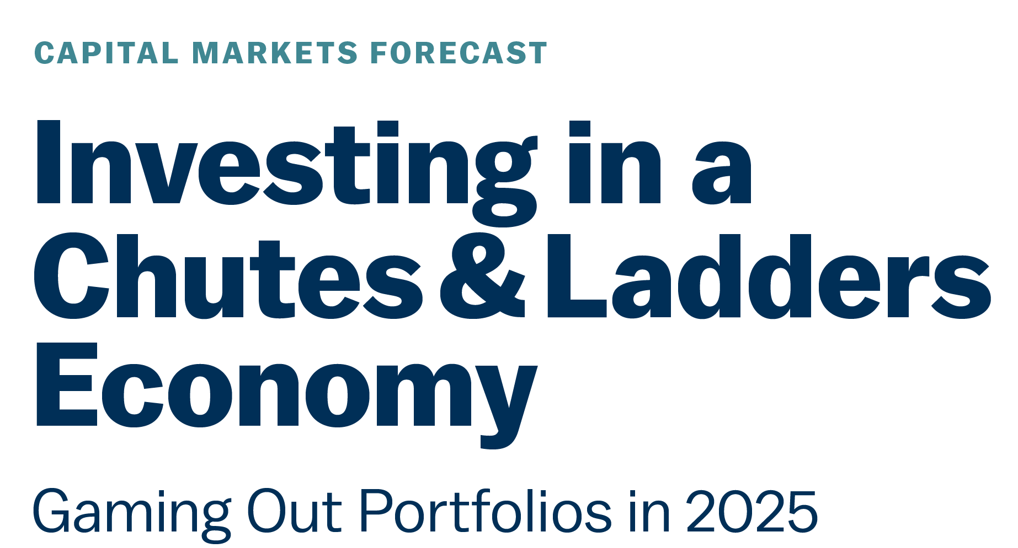
Tony Roth, Chief Investment Officer
Meghan Shue, Head of Investment Strategy
Luke Tilley, Chief Economist
January 2025

Slide 3
Investing in a chutes & ladders economy
Gaming out portfolios in 2025
Economic
Ladders
Mind
the Chutes
Playing the
Investment Game
Capital expenditures (capex) could get a boost
from tax incentives
Potential fiscal boost from
direct spending
Productivity already strengthening and could accelerate
Monetary policy
Deficits, interest rates, to constrain long-term growth
Tariff proposals pose downside risk for growth
Mass deportations would shrink the labor force, economy
Valuations a limiting factor
Merger & Acquisitions (M&A), fairer trade provide upside
Position for higher volatility
Overweight equities; tilt to U.S.
Investable themes: broadening leadership, consumer slowing, AI stratification, policy volatility
See Glossary in the Appendix for definitions of terms.

Slide 4
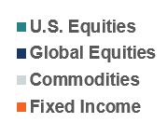
U.S. equity market the envy of the world
Asset Class Returns (2024)
Data as of December 31, 2024. Sources: WTIA, Bloomberg. Magnificent 7 represented by the following: Nvidia, Apple, Microsoft, Alphabet, Amazon, Meta, Tesla. Global ex-U.S. is represented by the MSCI ACWI ex-U.S. index, international developed is represented by the MSCI EAFE index, emerging markets is represented by the MSCI EM index, IG bonds is represented by the U.S. aggregate bond index. *The gold industry can be significantly affected by international monetary and political developments as well as supply and demand for gold and operational costs associated with mining.
Investing involves risks, and you may incur a profit or a loss. Past performance cannot guarantee future results.

Slide 5
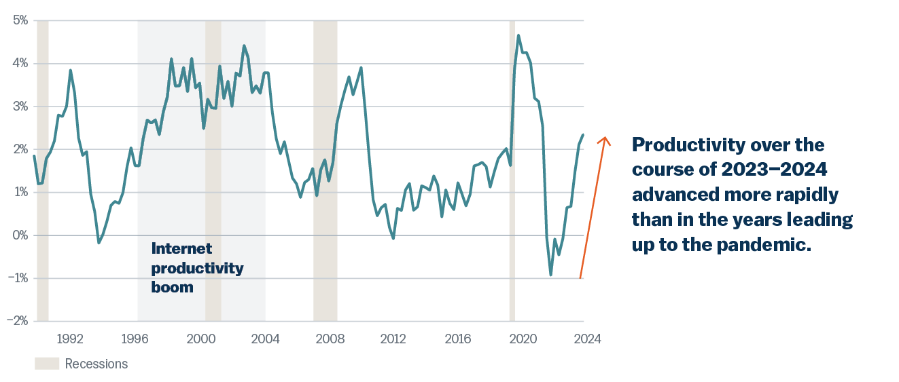
Productivity is gaining steam and could continue
Business sector output per hour worked (8 quarter annualized %)
Data as of December 1, 2024. Source: Bureau of Economic Analysis, Wilmington Trust.

Slide 6
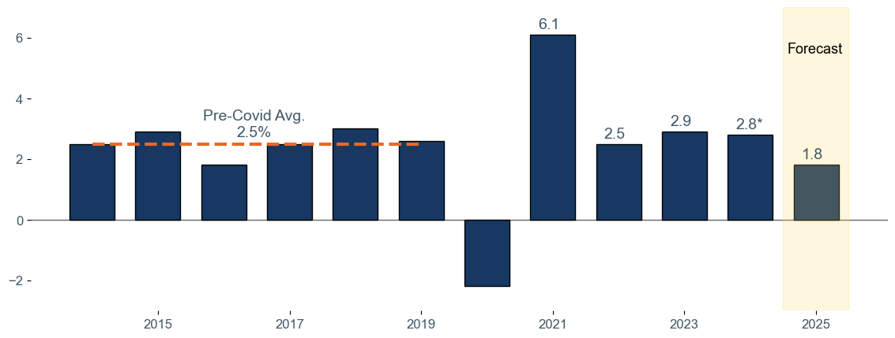
Economic growth set to decelerate in 2025
U.S. Real Gross Domestic Product Growth (y/y%)
*The last quarter of 2024 is an estimate
Data as of September 30, 2024. Sources: Bureau of Economic Analysis, Wilmington Trust.

Slide 7
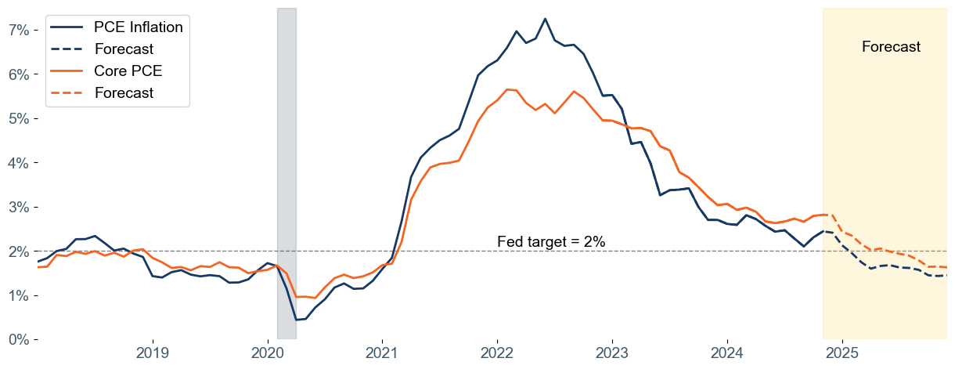
We expect inflation to fall below Fed’s target
Personal Consumption Expenditure (PCE) Index Inflation (y/y%)
Data as of November 30, 2024. Sources: Bureau of Economic Analysis, Wilmington Trust.

Slide 8
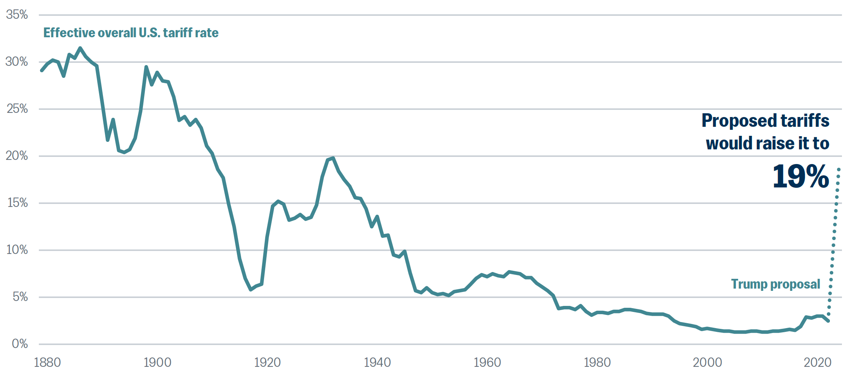
Proposed tariffs would be the highest in 90 years
Effective overall tariff rate (%)
Source: Yale Budget Lab, Wilmington Trust.

Slide 9
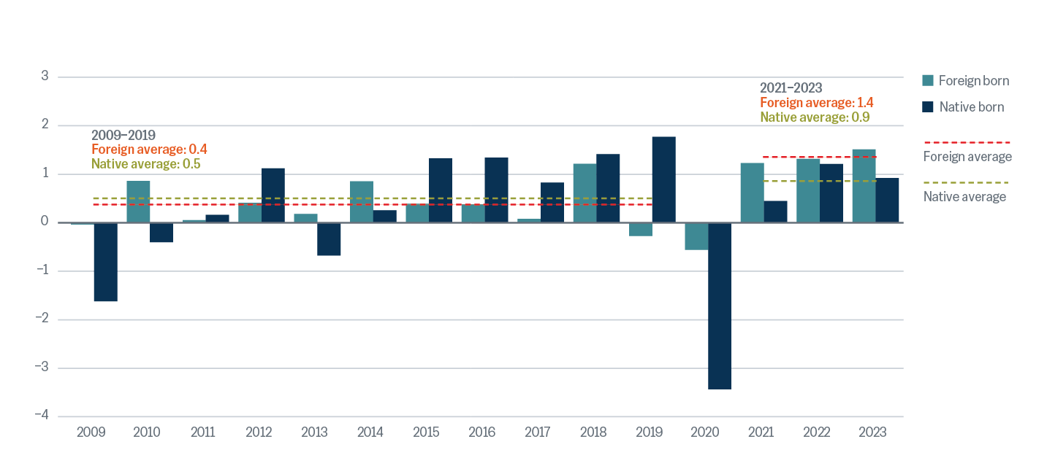
Immigration has been a key source of labor post pandemic
Annual labor force growth by place of birth 2014–2023 (millions)
Source: Bureau of Labor Statistics, Wilmington Trust.

Slide 10
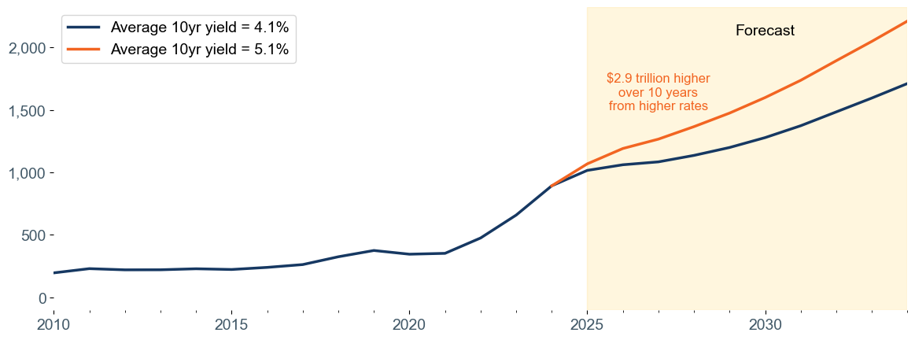
Higher interest rates would drive interest cost higher
Net interest under Congressional Budget Office baseline forecast and impact of higher rate ($billions)
Data as of December 31, 2024. Source: Congressional Budget Office, Wilmington Trust.

Slide 11
Interest rates a barometer for the market
10-year nominal U.S. Treasury yield and real rates
Current: 4.57%
Avg: 3.0%
Data as of December 31, 2024. Sources: WTIA, Bloomberg.

Slide 12
U.S. large cap valuations elevated
U.S. equity valuations (Next Twelve Months (NTM) P/E ratio, since 1990)
Current multiple, 21.7x
90th percentile since 1990
Data as of December 31, 2024. Sources: WTIA, Bloomberg.
Investing involves risks, and you may incur a profit or a loss. Past performance cannot guarantee future results.

Slide 13
Positioning portfolios: Managing risk, seeking opportunity
INVESTABLE IDEA | VIEW | OPPORTUNITY
Broadening leadership | Expect S&P 500 broadening to reassert itself as earnings recover in lagging sectors | Banks Materials Healthcare
Consumer slowing | A more discerning consumer expected to create winners and losers in the consumer discretionary and staples sectors | Internet retail Warehouse stores Home improvement
AI stratification | Anticipate that the AI investment opportunity will evolve from “pure play” chips and infrastructure “picks & shovels” toward software and cross-sector consumers of AI | Service companies using AI agents Healthcare companies utilizing AI in R&D
Policy volatility | Be cautious on companies and sectors that could get caught in the crosshairs of policy | Underweight industrials Selective within Real Estate Investment Trust (REITs)
Represent WTIA views as of December 31, 2024.

Slide 14
Thank you for joining

Slide 15

Tony Roth
BIOGRAPHY
Chief Investment Officer
Tony Roth is chief investment officer for Wilmington Trust Investment Advisors, Inc., the investment advisory arm of Wilmington Trust and M&T Bank. Tony plays a key role in developing and delivering investment services for our wealth, institutional, and brokerage clients. He provides strategic direction for the firm’s asset management investment activities including asset allocation, manager research, and portfolio construction. Tony leads the firm’s Investment Committee.
Tony joined Wilmington Trust in 2014 with extensive experience in wealth management and investment advisory. Prior to joining Wilmington Trust, he was chief investment officer (CIO) for Aquitaine Management in New York. Before that, he worked for UBS Wealth Management Americas as CIO, where he founded the Ultra High Net Worth Chief Investment Office. Earlier in his career, he was founder and co-head of the Advisory Services Division at Bear, Stearns & Co. Inc., served as director of the Family Wealth Group at Sanford C. Bernstein & Co., and was a tax attorney at Cleary Gottlieb in New York.
Tony earned his law degree from Harvard Law School. He holds master’s degrees in French and international tax law from Université Panthéon Sorbonne, and graduated magna cum laude from Brown University with a degree in philosophy.
Contact Information
150 N. Radnor Chester Road
Suite E-300
Wayne, PA 19087
610.977.4001
amroth@wilmingtontrust.com
Specializing In
Asset management
Wealth management
Equities
Fixed income
Hedge funds
Alternative investments
Notes:
Sample bio page

Slide 16

Meghan Shue
BIOGRAPHY
Head of Investment Strategy & Portfolio Construction
Meghan is responsible for helping manage the end-to-end asset allocation process, developing market research, and communicating the investment team’s market outlook and positioning to clients and prospective clients. She is a member of the Investment Committee, which is responsible for deriving the firm’s strategic and tactical asset allocation positioning.
Meghan also oversees the firm’s portfolio construction process—including implementation of asset class views through a variety of proprietary, non-proprietary, passive, active, and factor-based solutions—and chairs the Portfolio Management Committee.
Prior to joining Wilmington Trust, Meghan was an investment strategist at Bessemer Trust, where she helped manage the asset allocation decision and implementation process, performed asset allocation and market research, and published pertinent thought leadership.
She holds an MBA with a concentration in finance from the University of Miami, where she was valedictorian of her graduating class. She also holds a bachelor’s degree in engineering, with a concentration in operations research and financial engineering, from Princeton University, where she was also captain of the swimming & diving team.
Meghan is a regular CNBC contributor and is frequently quoted in financial media communicating the firm’s economic and market views. She was also named to the American Banker’s Most Powerful Women In Banking: Next 2022 list.*
Contact Information
150 N. Radnor Chester Road
Suite E-300
Wayne, PA 19087
610.977.4046
mshue@wilmingtontrust.com
Specializing In
Investment strategy
Asset allocation
Portfolio construction
* Please see link for more information about awards: https://www.wilmingtontrust.com/about-us/awards
Notes:
Sample bio page

Slide 17

Luke Tilley
BIOGRAPHY
Chief Economist and Department Head
Luke is chief economist and head of Asset Allocation & Quantitative Services for Wilmington Trust Investment Advisors (WTIA), a part of the M&T Bank family. Luke is also a member of WTIA’s Investment Committee.
Prior to joining Wilmington Trust in 2015, Luke was an officer and economic advisor with the Federal Reserve Bank of Philadelphia. Earlier in his career, Luke worked as a senior economist at IHS Global Insight (now IHS Markit) and as an economist for the U.S. Department of Housing and Urban Development.
Luke holds a Ph.D. in economics from Temple University and a bachelor’s degree in economics and history from James Madison University. He is the current chair of the American Bankers Association Economic Advisory Committee; a former president of the Philadelphia Council for Business Economics, a chapter of the National Association for Business Economics; and a former adjunct faculty member at Temple University.
Contact Information
150 N. Radnor Chester Road
Suite E-300
Wayne, PA 19087
610.977.4044
ltilley@wilmingtontrust.com
Specializing In
Economics
Monetary policy
Notes:
Sample bio page

Slide 18
Appendix

Slide 19
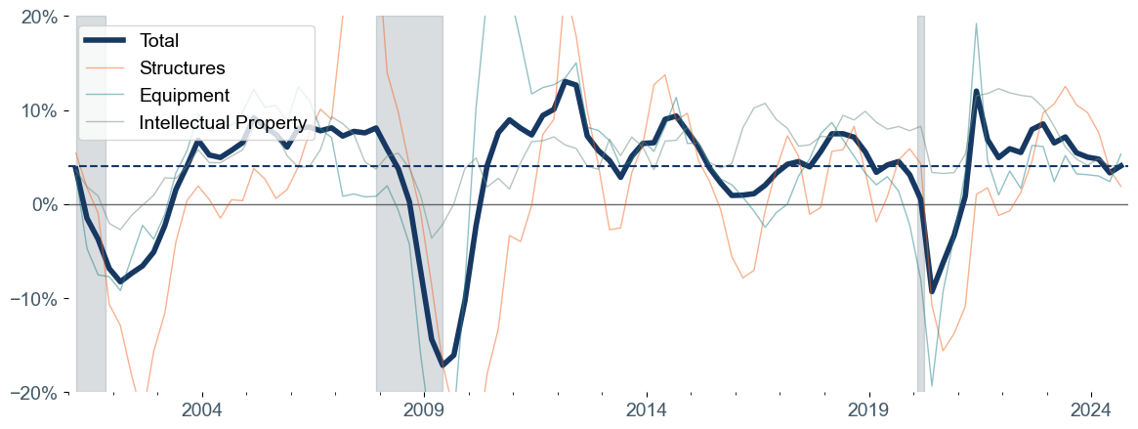
Capex has slowed but could get a boost from incentives
Real capital investment by type (y/y%)
Data as of 3Q 2024. Grey bars indicate recessionary periods.
Sources: Bureau of Economic Analysis, Wilmington Trust.

Slide 20
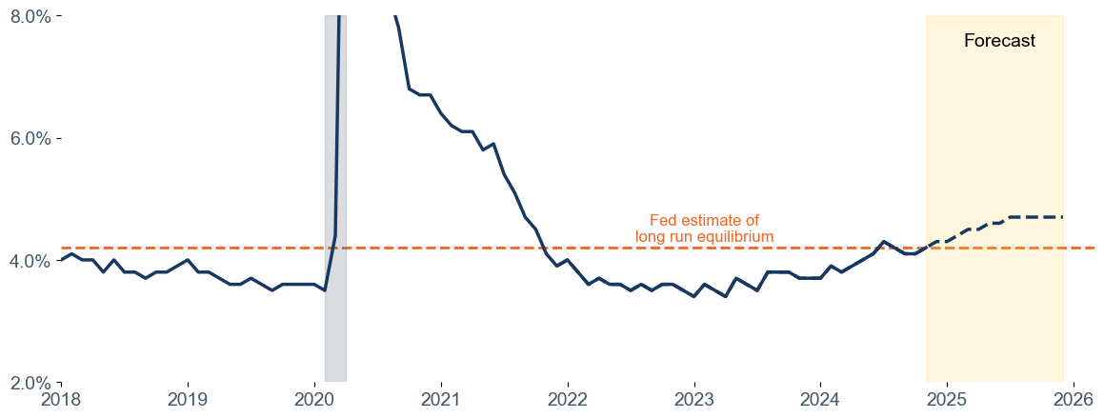
Joblessness to rise above Fed estimate of equilibrium
Unemployment Rate (%)
Grey bars indicate recessionary periods.
Data as of December 31, 2024. Sources: Bureau of Labor Statistics, Wilmington Trust.

Slide 21
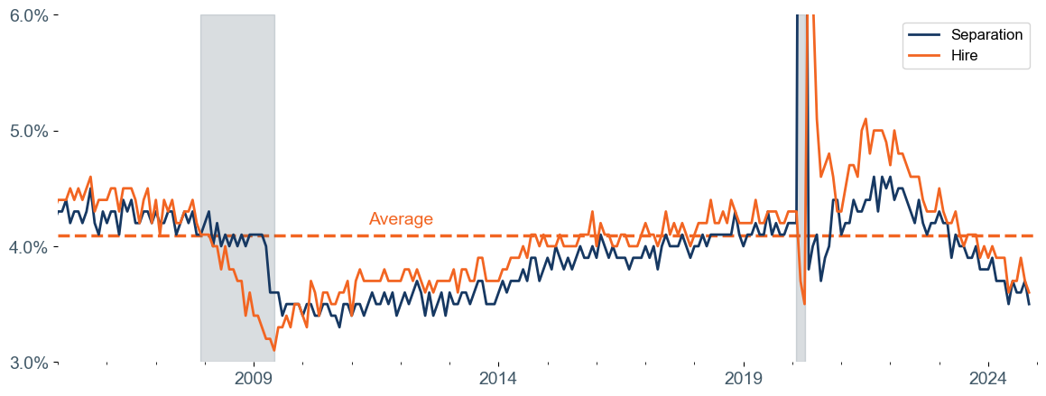
Labor market churn has slowed to a crawl
Hire and separation rates (%)
Data as of December 31, 2024. Sources: Bureau of Labor Statistics, Wilmington Trust.
Grey bars indicate recessionary periods.

Slide 22
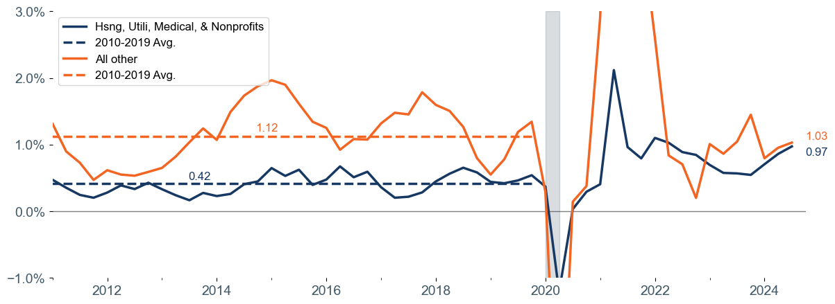
Non-discretionary outsized share of consumer spending
Contributions to Real GDP Growth (y/y%)
Data as of September 30, 2024. Source: Bureau of Economic Analysis, Wilmington Trust.
Grey bars indicate recessionary periods. “All other” refers to all other components of consumer spending not included in housing, utilities, medical care, and nonprofit spending.

Slide 23
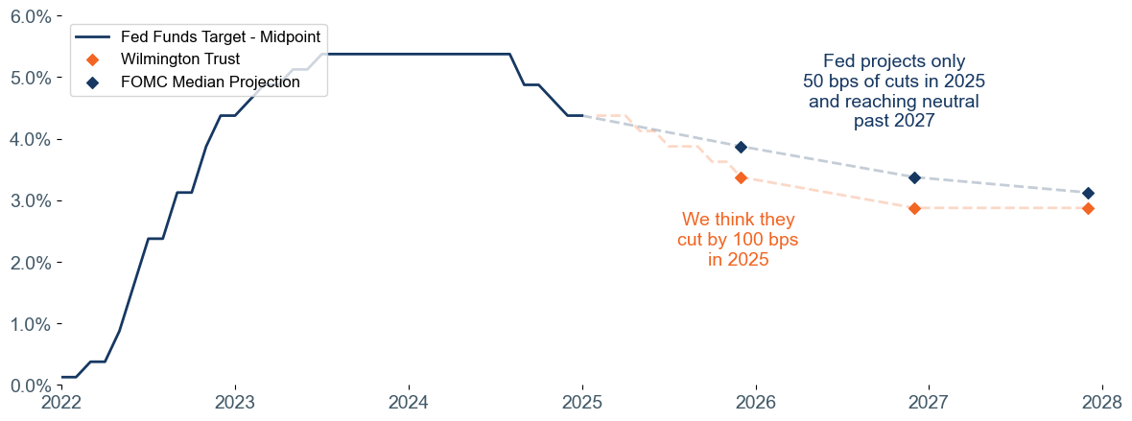
We expect more rate cuts in 2025 than Fed’s recent forecast
Federal funds rate target and projection (%)
*
*Federal Open Market Committee (FMOC)
Sources: Federal Reserve Board, Wilmington Trust

Slide 24
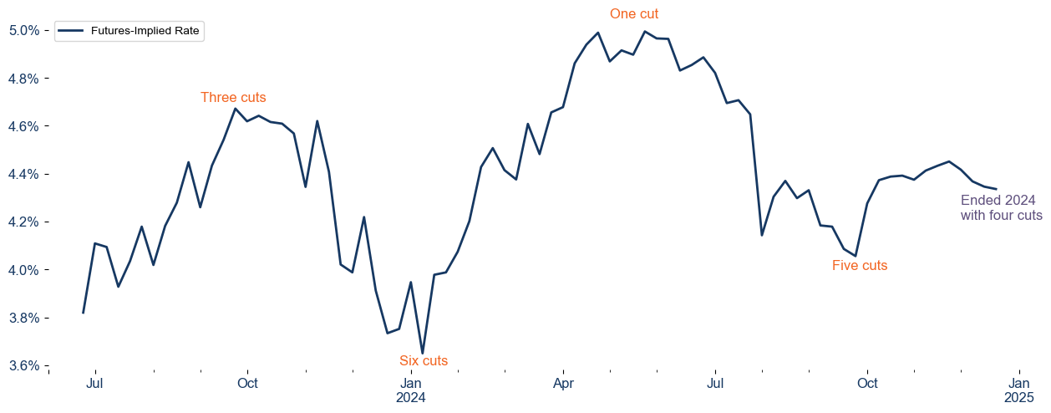
Market predictions for rate cuts can shift significantly
Fed funds futures predictions for rate at end of 2024
Sources: Bloomberg, Wilmington Trust.

Slide 25
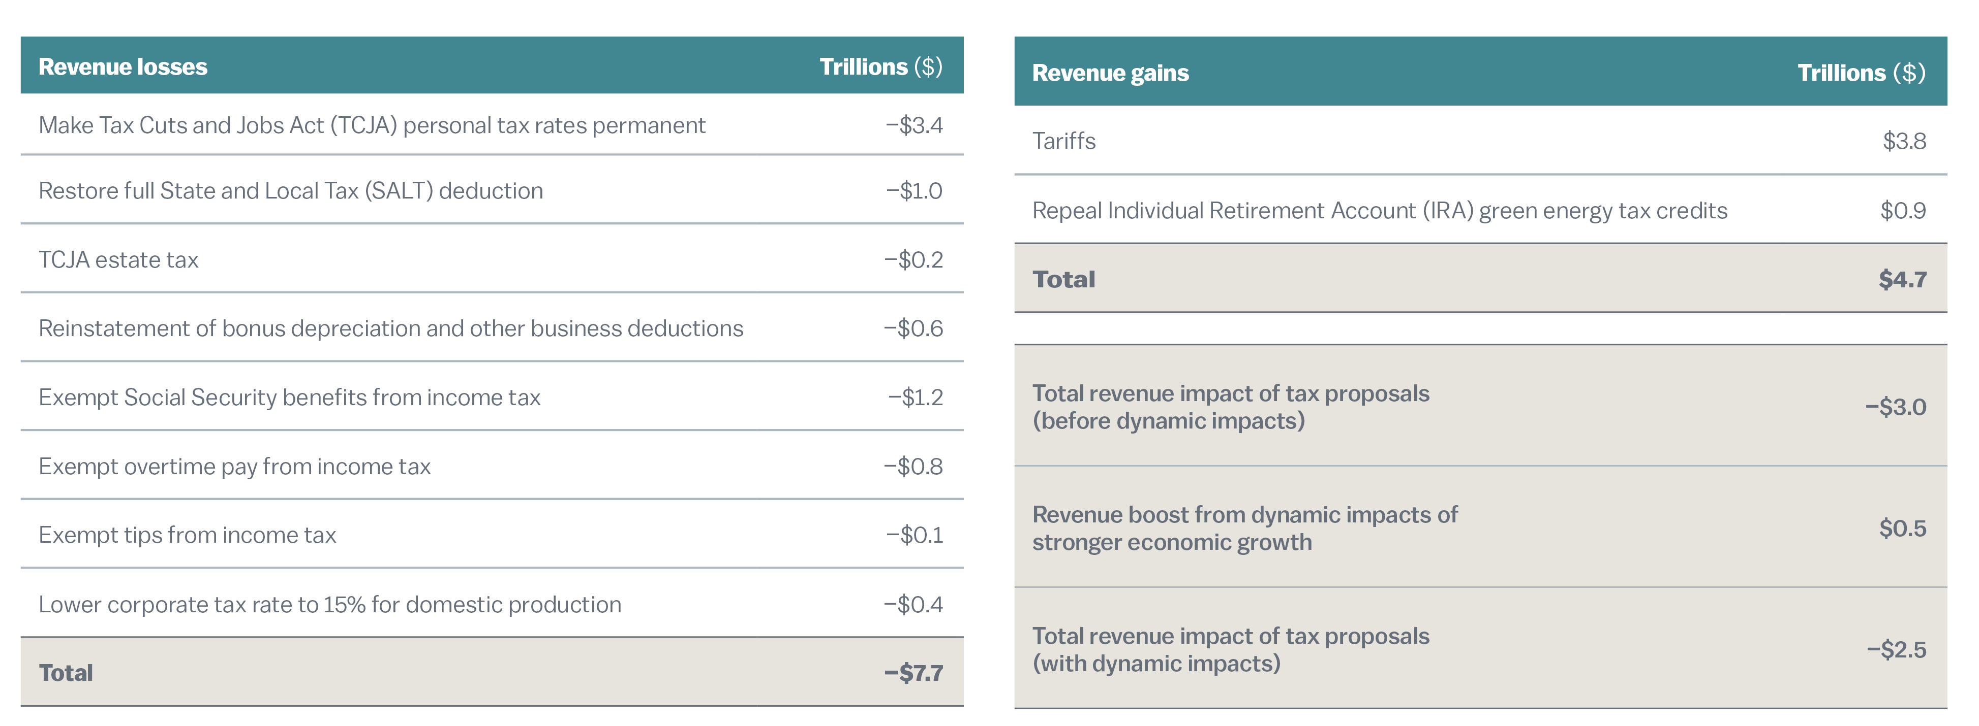
Campaign proposals would widen deficits
Source: Tax Foundation, Wilmington Trust.

Slide 26
Valuations more suggestive of long-term return prospects
Valuations (NTM P/E) versus forward returns
Valuations tell us very little about
1-year return prospects for equities…
…but are much more predictive for
long-term average returns.
Implied annualized return = 1.5%
Current: 21.7
Current: 21.7
R-squared is a statistical measure that represents the proportion of the variance for a dependent variable that's explained by an independent variable.
Data as of December 31, 2024. Sources: WTIA, Bloomberg, UBS. Analysis starts in 1990. Investing involves risks, and you may incur a profit or a loss. Past performance cannot guarantee future results.

Slide 27
Tech stocks look very different from 2000 bubble
Technology and interactive media (% of total index weight and index earnings contribution, S&P 500)
Data as of December 31, 2024 and June 30, 2000. Sources: Empirical Research Partners, WTIA. Chart represents S&P 500 index weights and earnings contribution.
Investing involves risks, and you may incur a profit or a loss. Past performance cannot guarantee future results.

Slide 28
Market concentration a challenge for portfolio construction
S&P “top 10” stocks as a percentage of total market cap
Current: 37.8%
Data as of December 31, 2024. Sources: WTIA, Bloomberg. S&P “top 10” represents the 10 largest stocks (measured by market cap) in the S&P 500 index at the current time.
Investing involves risks, and you may incur a profit or a loss. Past performance cannot guarantee future results.

Slide 29
International equities trading at historic discount to U.S.
NTM P/E premium/discount MSCI EAFE to S&P 500
EAFE equities trading at a premium
Long-term average: 0.86x
EAFE equities trading at a discount
Current: 0.58x
Data as of December 31, 2024. Sources: WTIA, Bloomberg, Strategas. NTM represents the “next twelve months” forward price to earnings estimate.
Investing involves risks, and you may incur a profit or a loss. Past performance cannot guarantee future results.

Slide 30
Growth of AI to play out in the energy sector
Global electricity consumption from data centers (TWh)
+117% growth in consumption
Data as of January 24, 2024. Source: IEA 2024 Annual Electricity Analysis and Forecast. TWh: Terawatt-hour

Slide 31
Disclosures
Wilmington Trust is a registered service mark used in connection with various fiduciary and non-fiduciary services offered by certain subsidiaries of M&T Bank Corporation including, but not limited to, Manufacturers & Traders Trust Company (M&T Bank), Wilmington Trust Company (WTC) operating in Delaware only, Wilmington Trust, N.A. (WTNA), Wilmington Trust Investment Advisors, Inc. (WTIA), Wilmington Funds Management Corporation (WFMC), Wilmington Trust Asset Management, LLC (WTAM), and Wilmington Trust Investment Management, LLC (WTIM). Such services include trustee, custodial, agency, investment management, and other services. International corporate and institutional services are offered through M&T Bank Corporation’s international subsidiaries. Loans, credit cards, retail and business deposits, and other business and personal banking services and products are offered by M&T Bank, Member FDIC. Not all services are available through every domestic and international affiliate or in all jurisdictions.
Wilmington Trust Investment Advisors, Inc., a subsidiary of M&T Bank, is an SEC-registered investment adviser providing investment management services to Wilmington Trust and M&T affiliates and clients. Wilmington Funds are entities separate and apart from Wilmington Trust and M&T Bank.
Registration with the SEC does not imply a certain level of skill or training. Additional Information about WTIA is also available on the SEC’s website at adviserinfo.sec.gov.
Wilmington Trust Investment Advisors, Inc.’s Capital Markets Forecast is provided for informational purposes only and is not intended as an offer or solicitation for the sale of any financial product or service or as a recommendation or determination that any investment strategy is suitable for a specific investor. Investors should seek financial advice regarding the suitability of any investment strategy based on the investor’s objectives, financial situation, and particular needs. The investments or investment strategies discussed herein may not be suitable for every investor. The material is not designed or intended to provide legal, investment, or other professional advice since such advice always requires consideration of individual circumstances. If legal, investment, or other professional assistance is needed, the services of an attorney or other professional should be sought.
The forecasts presented herein constitute the informed judgments and opinions of Wilmington Trust about likely future capital market performance. Forecasts are subject to a number of assumptions regarding future returns, volatility, and the interrelationship (correlation) of asset classes. Assumptions may vary by asset class. Actual events or results may differ from underlying estimates or assumptions, which are subject to various risks and uncertainties.
Some investment products may be available only to certain “qualified investors”—that is, investors who meet certain income and/or investable asset thresholds. Any offer will be made only in connection with the delivery of the appropriate offering documents, which are available to prequalified persons upon request.
Reference to specific securities or company names mentioned in this material are merely for explaining the market view and should not be construed as investment advice or investment recommendations of those companies. No assurance can be given as to actual future market results or the results of Wilmington Trust’s investment products and strategies. The estimates contained in this presentation constitute Wilmington Trust’s judgment as of the date of these materials and are subject to change without notice. The information in this presentation has been obtained or derived from sources believed to be reliable, but no representation is made as to its accuracy or completeness.
Securities listed or mentioned are provided for illustrative purposes only and are not intended to be representative of current recommendations or holdings. It should not be assumed that these securities were or will be profitable.
The gold industry can be significantly affected by international monetary and political developments as well as supply and demand for gold and operational costs associated with mining.
Investing involves risks, and you may incur a profit or a loss. Past performance cannot guarantee future results. Diversification does not ensure a profit or guarantee against a loss. There is no assurance that any investment strategy will be successful.
Benchmarks and financial indices are shown for illustrative purposes only. Such benchmarks and indices are not available for direct investment, and their performance does not reflect the expenses associated with the management of an actual portfolio, the actual cost of investing in the instruments that comprise it, or other fees. Indices are not available for direct investment. Investment in a security or strategy designed to replicate the performance of an index will incur expenses, such as management fees and transaction costs, that would reduce returns.
Benchmarks and financial indices referenced herein are representative of large and small domestic and international stocks and bonds, each with unique risks.
Third-party trademarks and brands are the property of their respective owners. Third parties referenced herein are independent companies and are not affiliated with M&T Bank or Wilmington Trust. Listing them does not suggest a recommendation or endorsement by Wilmington Trust.
Investments: Are NOT FDIC Insured * Have NO Bank Guarantee *
May Lose Value
Notes:
Sample disclosure page.
Note that disclosure has its own master page. Smaller text in two columns The copyright DOES NOT include “Please see disclosures…”

Slide 32
Disclosures
Index Descriptions
The Bloomberg U.S. Aggregate Index measures the performance of the entire U.S. market of taxable, fixed-rate, investment-grade bonds. Each issue in the index has at least one year left until maturity and an outstanding par value of at least $250 million.
The Bloomberg U.S. High Yield Corporate Index, formerly known as Lehman Brothers U.S. High Yield Corporate Index, measures the performance of taxable, fixed-rate bonds issued by industrial, utility, and financial companies and rated below investment grade. Each issue in the index has at least one year left until maturity and an outstanding par value of at least $150 million.
The Bloomberg World Government Inflation-Linked Bond (WGILB) Index measures the performance of investment grade, government inflation-linked debt from 12 different developed market countries.
Bloomberg Commodity Index measures the performance of 19 futures contracts on physical commodities. As of the annual reweighting of the components, no related group of commodities (for example, energy, precious metals, livestock, and grains) may constitute more than 33% of the index and no single commodity may constitute less than 2% or more than 15% of the index.
The Dow Jones Global ex-U.S. Index is an equal-weighted stock index composed of the stocks of 150 top companies from around the world (excluding the U.S.) as selected by Dow Jones editors and based on the companies' long history of success and popularity among investors. The Global Dow is designed to reflect the global stock market and gives preferences to companies with global reach.
The HFRX Global Hedge Fund Index is designed to be representative of the overall composition of the hedge fund universe. It is composed of all eligible hedge fund strategies; including but not limited to convertible arbitrage, distressed securities, equity hedge, equity market neutral, event driven, macro, merger arbitrage, and relative value arbitrage. The strategies are asset weighted based on the distribution of assets in the hedge fund industry.
The MSCI All-Country World Index ex USA measures the performance of large- and mid-capitalization stocks in approximately 50 developed and emerging equity markets, excluding the United States.
The MSCI EAFE® (net) Index measures the performance of approximately 20 developed equity markets, excluding those of the United States and Canada. The total returns of the index are net of the maximum tax withholding rates that apply in many countries to dividends paid to nonresident investors.
The MSCI Emerging Markets Index captures large- and mid-cap representation across 26 emerging markets countries. With 1,198 constituents, the index covers approximately 85% of the free-float-adjusted market capitalization in each country.
Russell 1000® Growth Index measures the performance of those Russell 1000 Index companies with higher price-to-book ratios and higher forecasted growth values.
Russell 1000® Value Index measures the performance of those Russell 1000 Index companies with lower price-to-book ratios and lower forecasted growth values.
The Russell 2000® Index measures the performance of the 2,000 smallest companies in the Russell 3000 Index, which represents approximately 8% of the total market capitalization of the Russell 3000 Index. As of its latest reconstitution, the index had a total market capitalization range of approximately $128 million to $1.3 billion.
The Russell 3000® Index measures the performance of the 3,000 largest U.S. companies based on total market capitalization, which represents approximately 98% of the investable U.S. equity market. As of its latest reconstitution, the index had a total market capitalization range of approximately $128 million to $309 billion.
The S&P 500 Index measures the performance of approximately 500 widely held common stocks listed on U.S. exchanges. Most of the stocks in the index are large-capitalization U.S. issues. The index accounts for roughly 75% of the total market capitalization of all U.S. equities.
The S&P Developed Property defines and measures the investable universe of publicly traded property companies domiciled in developed markets.
The S&P 500® Equal Weight Index (EWI) is the equal-weight version of the widely-used S&P 500. The index includes the same constituents as the capitalization weighted S&P 500, but each company in the S&P 500 EWI is allocated a fixed weight - or 0.2% of the index total at each quarterly rebalance.
The S&P Municipal Bond High-Yield Index consists of bonds in the S&P Municipal Bond Index that are not rated or are rated below investment grade.
The S&P Municipal Bond Index is a broad, market value-weighted index that seeks to measure the performance of the U.S. municipal bond market.
The S&P United States REIT Index measures the investable U.S. real estate investment trust market and maintains a constituency that reflects the market’s overall composition.
The UBS Magnificent Seven (Mag7) Index refers to a group of seven US technology superpowers that are considered to have significant competitive advantages, or "moats," in their respective markets. These companies are often highlighted for their dominant positions and substantial contributions to market performance. The Magnificent Seven typically includes: Apple, Microsoft, Alphabet (Google), Amazon, Meta (Facebook), NVIDIA, and Tesla.

Slide 33
Disclosures
Definitions
The 10-year nominal US Treasury bond yield is the interest rate the US government pays to borrow money for 10 years through the issuance of Treasury notes.
Capital expenditures (capex) is the money an organization or corporate entity spends to buy, maintain, or improve its fixed assets, such as buildings, vehicles, equipment, or land.
Dividend yield is a financial ratio that shows how much a company pays out in dividends each year relative to its stock price.
Earnings contribution refers to the portion of a company's total earnings that is attributed to a specific segment or division.
Multiple expansion is a financial strategy where an asset is purchased and sold for a higher valuation multiple. It's a type of arbitrage, which is a way to profit from price differences in different markets.
Personal consumption expenditures (PCE) is a measure of how much money US households spend on goods and services.
The core Personal Consumption Expenditures (PCE) price index is a measure of the prices paid by consumers for goods and services, excluding food and energy.
The price-to-earnings (P/E) ratio measures a company's current share price relative to its per-share earnings.
The price-to-earnings (P/E) multiple is used to compare a company's market value (price) with its earnings. A company with a price or market value that is high compared to its level of earnings has a high P/E multiple. A company with a low price compared to its level of earnings has a low P/E multiple.
A real interest rate is one that has been adjusted for inflation, reflecting the real cost of funds to the borrower and the real yield to the lender.
Total return is a performance measure that reflects the actual rate of return of an investment or a pool of investments over a given evaluation period.

